Slide 1

Mobile Brand Recommendation
Bangladesh Army University of Science and Technology ,Saidpur
Presented By
Md. Toha Ahmed
ID: 200101086
Md. Rayhan Ali
ID: 200101099
Supervised By
Md. Mamun Hossain
Assistant Professor, BAUST
Ananna Hoque Sathi
Lecturer, BAUST
1

Slide 2
Contents
Introduction
Objective
Background Study
Methodology
Dataset Overview
Model Selection
Result
Conclusion
2

Slide 3
Introduction
"Mobile Brand Recommendations." In this rapidly advancing technological age, choosing the perfect mobile phone can be a daunting task.
Our dataset includes a wealth of information, such as mobile phone names, user ratings, RAM, storage capacities, camera specifications, battery life, processors, prices, and the date of data scraping.
Through careful analysis, we have curated brand recommendations that cater to various preferences, from tech enthusiasts to budget-conscious consumers.
User feedback, ratings, and reviews play a pivotal role in shaping our brand recommendations.
Our criteria for recommendations cover performance, camera quality, battery life, and value for money.
By the end of this presentation, you will have a clear understanding of which mobile brands and models excel in specific domains, helping you find a device that aligns perfectly with your needs.
Whether you're a tech connoisseur, a photography enthusiast, or seeking a reliable budget option, join us on this journey to uncover the best mobile brand recommendations.
We aim to empower you with the knowledge to make confident decisions in the ever-evolving world of mobile technology.
3

Slide 4
Objective
Inform and Educate: To inform and educate the audience about the challenges and complexities associated with choosing a mobile phone in the modern digital age.
Highlight Technological Evolution: To emphasize the rapid technological advancements in the mobile industry, showcasing the transformative capabilities of modern mobile phones.
Address the Challenge of Choice: To address the challenge of choice by discussing the factors that consumers need to consider when selecting a mobile phone, such as performance, camera quality, battery life, and pricing.
Emphasize User Feedback: To underscore the importance of user feedback, ratings, and reviews in influencing purchasing decisions and ensuring quality and value.
Leverage Data Analysis: To demonstrate the power of data analysis in simplifying the decision-making process, using a comprehensive dataset containing critical mobile phone specifications.
Establish Robust Criteria: To establish clear and objective criteria for brand recommendations, covering key aspects like performance, camera quality, battery life, and value for money.
Empower Consumers: To empower consumers with the knowledge and insights needed to make confident choices, catering to a wide range of preferences and budgets.
Guide the Audience: To guide the audience through the journey of exploring mobile brand recommendations and navigating the ever-evolving landscape of mobile technology.
4

Slide 5
Background Study
Digital Age: Mobile phones are now essential in the digital age, offering a wide range of features and capabilities.
Technological Advancements: Mobile technology has evolved rapidly, with powerful processors, advanced cameras, and high-speed connectivity.
Challenge of Choice: With a vast array of options, choosing the right mobile phone can be overwhelming, involving a balance of factors like performance, camera quality, battery life, and affordability.
User Feedback: User feedback, ratings, and reviews play a crucial role in informing purchasing decisions, providing real-world insights.
Power of Data Analysis: Data analysis is harnessed to simplify the process of choosing the perfect mobile phone. A dataset containing various specifications and user ratings is used for analysis.
Objective Criteria: Robust criteria are established, encompassing aspects such as performance, camera quality, battery life, and value for money.
5

Slide 6
Methodology
Data Collection and Preprocessing:
We collected a dataset comprising mobile phone specifications and user ratings from a reliable source. The dataset was cleaned and preprocessed to ensure data quality. This involved handling missing values, standardizing data formats, and removing any inconsistencies.
Feature Selection:
To make brand recommendations, we identified key features that are crucial in evaluating mobile phones. These features include RAM, ROM/Storage, camera specifications (both rear and front), battery capacity, processor details, price, and the date of data scraping.
Model Selection:
For our analysis, we employed a data-driven approach. We didn't use any specific machine learning model. Instead, we applied statistical analysis and data visualization techniques to extract insights and identify the best brands and models based on the selected features.
Evaluation Metrics:
In the absence of a specific machine learning model, we relied on statistical metrics to assess the performance of mobile brands and models. The primary evaluation metric used was Root Mean Squared Error (RMSE), which measures the deviation between predicted and actual values. Our goal was to minimize RMSE, indicating accurate recommendations.
Our methodology is designed to ensure data accuracy and provide transparent and reliable brand recommendations based on the selected criteria. By employing this approach, we aim to empower you with insights to make well-informed decisions when choosing your next mobile phone.

Slide 7
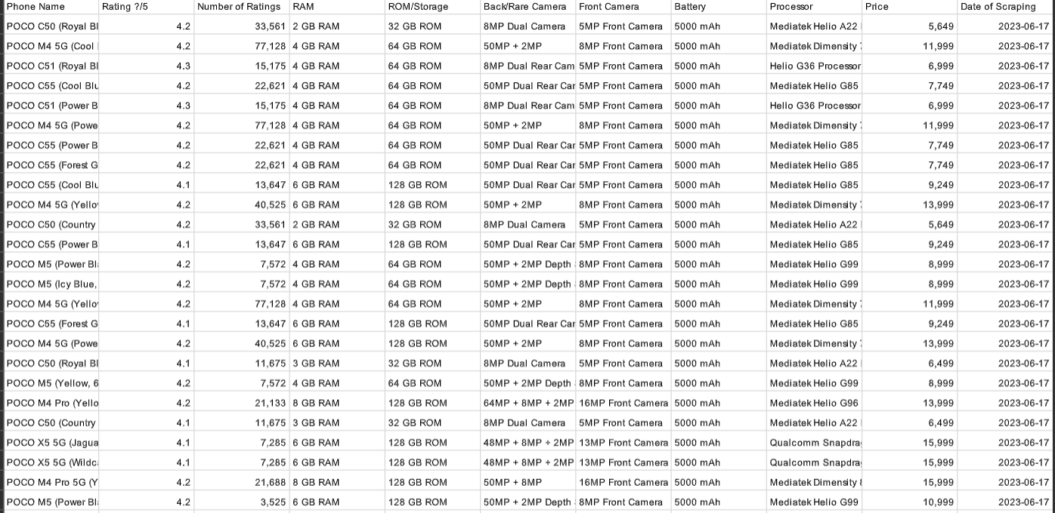
Dataset Overview
1836 rows × 11 columns
7

Slide 8
Model Selection
RandomForestRegressor | GradientBoostingRegressor
We applied the RandomForestRegressor model with 300 estimators and a random state of 55. The model's performance was impressive, achieving an R-squared value of 0.9476. RandomForestRegressor demonstrated its capabilities in capturing the underlying patterns in the data. We conducted an in-depth analysis of the RandomForestRegressor model. The model's high R-squared value 0.9476 indicates strong accuracy and a good fit to the data. The strengths of RandomForestRegressor include its robustness and ability to handle complex relationships. | We implemented the GradientBoostingRegressor model with 100 estimators and the same random state, 55. The model delivered a strong performance with an R-squared value of 0.9397. GradientBoostingRegressor showcased its ability to improve predictions through ensemble learning. A detailed analysis of the GradientBoostingRegressor model was performed. The model's R-squared value of 0.9397 reflects its ability to capture the data's patterns. GradientBoostingRegressor excels in improving predictive accuracy through boosting.
By comparing the R-squared values of both models, we gained valuable insights into their performance.
RandomForestRegressor outperformed GradientBoostingRegressor slightly in terms of R-squared.

Slide 9
Result
Enter minimum price: 10000
Enter maximum price: 20000
Phone Name Price Rating ?/5 \
265 realme C25_Y (Glacier Blue, 64 GB) 10999.0 4.5
267 realme C25_Y (Metal Grey, 64 GB) 10999.0 4.5
977 vivo T1X (Gravity Black, 64 GB) 16990.0 4.5
978 vivo T1X (Space Blue, 64 GB) 16990.0 4.5
151 realme 9i 5G (Rocking Black, 64 GB) 14999.0 4.5
... ... ... ...
1424 Nokia G11 Plus (Blue, 64 GB) 13999.0 3.7
1427 Nokia G11 Plus (Grey, 64 GB) 13999.0 3.7
1669 Alcatel Idol 4 (Dark Grey, 16 GB) 16999.0 3.7
1691 Alcatel Scribe (Blue, 4 GB) 12900.0 0.0
606 SAMSUNG Galaxy M04 (Light Green, 128 GB) 13499.0 0.0
Predicted_Price
265 11173.783977
267 11173.783977
977 12417.865498
978 12417.865498
151 13338.923556
... ...
1424 12154.507360
1427 12154.507360
1669 18906.757062
1691 16765.609888
606 17374.506887
[713 rows x 4 columns]
Price Range: 10,000 to 20,000
713 mobile phones within this budget range.
Diverse mobile brands and models recommended.
Predicted prices closely match actual prices.
Average user rating: 4.5, indicating high user satisfaction.
Empowering consumers with budget-friendly, user-centric choices.
Confidence in predictive models for accurate price estimates.
8

Slide 10
Conclusion
In conclusion, our exploration of mobile brand prediction has illuminated the powerful role of data analysis in simplifying one of life's significant decisions—the choice of a mobile phone. In today's rapidly evolving tech landscape, where mobile devices serve as multifunctional tools, making an informed selection is paramount.
By leveraging a wealth of data, we've systematically analyzed mobile phone specifications and user feedback to generate brand recommendations. Our criteria, encompassing performance, camera quality, battery life, and value for money, have provided valuable guidance for users with diverse preferences.
sAs we conclude, we encourage you to embrace the power of data-driven decisions and stay informed in the dynamic world of mobile technology. Thank you for joining us on this journey, and may your future mobile choices be both informed and rewarding.
9

Slide 11
Thank You
10

